Slide 1
Real time problem
A teacher wants to store a subject
marks for every student.
In her class , students count is 120
How to store values?
0 1 2 ……………… 119
subject[]

Slide 2
Real time problem
A teacher wants to store 5 subject
marks for every student.
In her class , students count is 120
0 1 2 ……………… 119
subject1[]
0 1 2 ……………… 119
subject2[]
.
.
0 1 2 ……………… 119
subject5[]

Slide 3
Design for large inputs
Too many arrays.
Lets find a solution
Goals
Arrays count != number of subjects
One array for entire set
Still identify inputs individually
Like first student’s first subject mark + second student’s first subject mark + …

Slide 4
Design for large inputs
row size = 2;
Solution:
marks[][] = {
{21, 24, 25, 28, 32},
{69, 42, 63, 45, 95}
};
marks
holds the list of numbers
Type – 2D Array: Indicated by [][]
Row size
Number of subjects in the array
Column size
Number of students in the array
Goals
Arrays count != number of subjects
One array for entire set
Still identify inputs individually
Like first student’s first subject mark + second student’s first subject mark + …
column size = 5;

Slide 5
Design for large inputs
marks[][] = {
{21, 24, 25, 28, 32},
{69, 42, 63, 45, 95}
};
How to access elements in the array???
First subject first student’s mark - marks[0][0]
First subject second student’s mark – marks[0][1]
Second subject last student’s mark ???
marks[1][4]
row size = 2;
column size = 5;

Slide 6
Memory Allocation
int marks[2][2];
marks[0][0] = 1
marks[0][1] = 2
marks[1][0] = 3
marks[1][1] = 4
How to access i^{th} element and j^{th} element?
Row Index = i – 1, Column Index = j - 1
Access it as marks[i - 1][j – 1]
Invalid indexing like marks[3][4] or marks[5][0]
1000
Syntax:
datatype arrayname[row size][column size];
1
marks[0][0]
1001
1002
marks[0][1]
2
1003
1004
3
marks[1][0]
1005
1006
4
marks[1][1]
1007
1008
1009
1010
1011

Slide 7
2D-Array
Memory
Static
Dynamic

Slide 8
2000 - 2001
1000
a
Static
#include<stdio.h>
int main()
{
int a[2][3]; // Array Declaration
int r, c;
scanf(“%d”%d”, &r, &c); // 2 2
for(int i=0; i<r; i++)
{
for(int j=0;j<c;j++)
{
scanf(“%d%d”,&a[i][j]);
}
}
1000
1
a[0][0]
1001
1002
a[0][1]
2
1003
1004
3
a[0][2]
1005
1006
4
a[1][0]
1007
1008
a[1][1]
1009
1010
a[1][2]
1011
Notes:
Title + Image + Text

Slide 9
2000 - 2001
1000
a
Static
for(int i=0; i<r; i++)
{
for(int j=0; j<c; j++)
{
printf(“%d”, a[i][j]);
}
}
}
1000
1
a[0][0]
1001
1002
a[0][1]
2
1003
1004
3
a[0][2]
1005
1006
4
a[1][0]
1007
1008
a[1][1]
1009
1010
a[1][2]
1011
Notes:
Title + Image + Text

Slide 10
a[0]
Memory Allocation
a[0][0]
1000
a[0]
a[1]
a[2]
a[0][1]
1002
a[0]
a[0][2]
1004
a[1]
a
a[1]
a[2]
a[1][0]
2000
a[0]
4000
1000
a[1][1]
2002
a
4000
a[1]
2000
4002
a[1][2]
2004
5000
a[2]
3000
4004
a[2]
a[2][0]
3000
a[2][1]
3002
a[2][2]
3004
Notes:
Title + Image + Text

Slide 11
Dynamic
Memory Allocation :
#include<stdio.h>
int main(){
int **a;
int r, c;
scanf(“%d%d”, &r , &c);
**
a =
( )malloc
int
( r *
sizeof(int * ));
for(int i = 0; i< r; i++) {
*(a+i)=(int *)malloc(c * sizeof(int ));
}
for(int i=0; i<r; i++){
for(int j=0; j<c; j++) {
scanf(“%d”, *((a+i) +j );
}
}

Slide 12
Dynamic
Memory Allocation :
for(int i = 0; i< r; i++) {
*(a+i)=(int *)malloc(c * sizeof(int ));
}
for(int i=0; i<r; i++) {
for(int j=0; j<c; j++) {
printf(“%d”, *((a+i) +j );
}
}
}

Slide 13


Applications
Image Processing Speech Processing

Slide 14
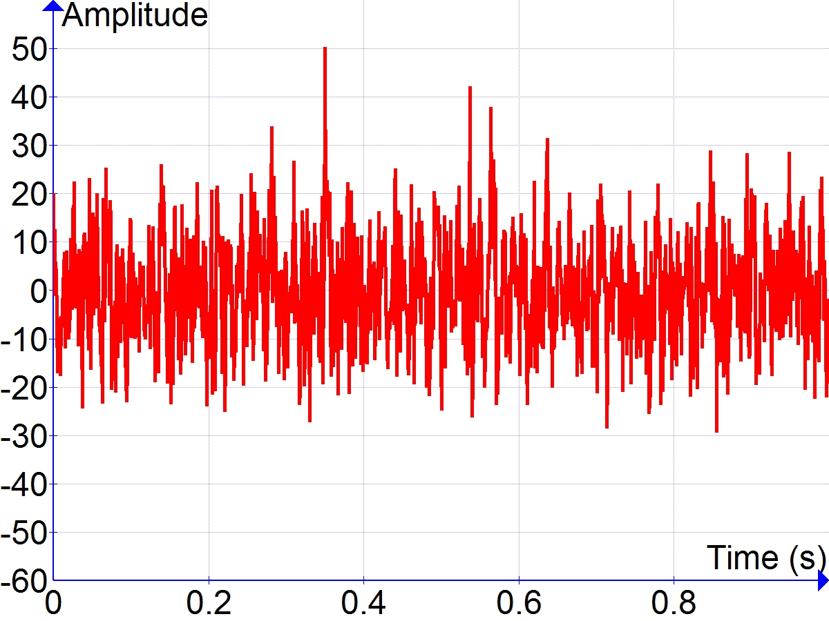
Applications
Signal Processing

Slide 15

THANK YOU
Notes:
Thank you slide

